Slide 1
Azure Defender for IoT
200.8 Successful Deployment

Slide 2
Agenda
Deployment Process
Prerequisites & Site Preparations
On boarding
Sanity and finetuning
Azure Defender for IoT documentation
Notes:
Point out website

Slide 3

Multiple deployment options
100% On-Premises
On-premises sensors connected to on-premises SIEM (Splunk, etc.)
Hybrid
On-premises sensors managed locally & connected to cloud-based SIEM (e.g., Azure Sentinel)
Cloud
On-premises sensors managed via Azure Security Center and connected to Azure Sentinel
Notes:
On Prem – may be required by regulatory
Local CM

Slide 4

How Azure Defender for IoT platform works
Sensor: Physical appliance or Virtual Machine
Plugs into network span port / network tap
Ability to connect to multiple switches
“Smart Sensor” fully passive - nonintrusive
PCAP analysis capabilities
On-premise management web console or managed via Azure Security Center
Native SIEM integration
Enterprise
IT
Lv. 4 & 5
DMZ
Lv. 3/3.5
Supervisory
Lv. 2
OT
Process Control
Lv. 1
Cell/Area
Lv. 0
Management Port
Managed Switch with Port Mirroring
SPAN
Corporate Network
One way Traffic Data
Monitored port
(source)
Analysis port
(source)
One way
DMV
Industrial Zone 1
Industrial Zone 1
Industrial Zone 1
HMI
PLC/RTU
Engineering Station
OT Network
Notes:
The connection to the switch is done by Ethernet cable between the switch’s SPAN port and port on CyberX sensor that listens to mirrored data
Another option is to use network TAP for the traffic mirroring
Physical sensor receives traffic from up to 9 managed switches
Platform allows access to raw PCAPs for farther investigation (ability to record, load and play PCAPs using the platform core capabilities )
Splunk
Qradar
ArcSignt
Netwitness

Slide 5
Recommended Deployment Process
1. Gather site Information
(Managed Switches, VLANS, assets count, network architecture)
2. Review received Information, subscribe to the service via Azure portal
(Where to deploy, monitoring coverage)
3. Site Preparation and Configuration
(SPAN, IP, FW, order HW)
4. Pre-Deployment Validation
(PCAP)
5. On boarding, Sanity, Finetuning
Notes:
The first Part of achieving a successful deployment, is the preparations, its important to follow the following procedure in order to achieve a fast and successful on boarding onto the platform
Pre deployment overview of the industrial network is essential to define the proper location for CyberX, required configurations and validations
1 Review your network, mark the relevant managed switches, the (OT) VLANS in focus, estimated assets count for monitoring, 2 Overview the network architecture, where to deploy, how many collectors are required,
3 Prepare your site for deployment: SPAN config, Open FW rules, order HW,
4 Record sample traffic from the SPAN port
5 Install or connect the preconfigured appliance, sanity

Slide 6
Nine Step Deployment Process
 | Task | Owner | Scale
1 | Identify the solution infrastructure (Network Architecture, equipment) | PM, OT engineer | Per site
2 | Register with Azure Defender for IoT | Subscription contributor | # Committed devices
3 | Site preparation (HW order, SPAN, cabling, FW, static IPs, validation PCAP) | OT engineer | Per site
4 | Install and set up the On-Premises Management console | IT / OT engineer | On going
5 | On board a sensor to Azure portal | Subscription contributor | Per Sensor
6 | Deployment - Install and set up the sensor | IT / OT engineer | Per site
7 | Connect sensors to an On-Premises Management console | IT / OT engineer | Per Sensor
8 | Configurations, fine Tuning, optimization | IT / OT engineer | Per site
9 | Handoff to operations | IT / OT engineer | Per site

Slide 7
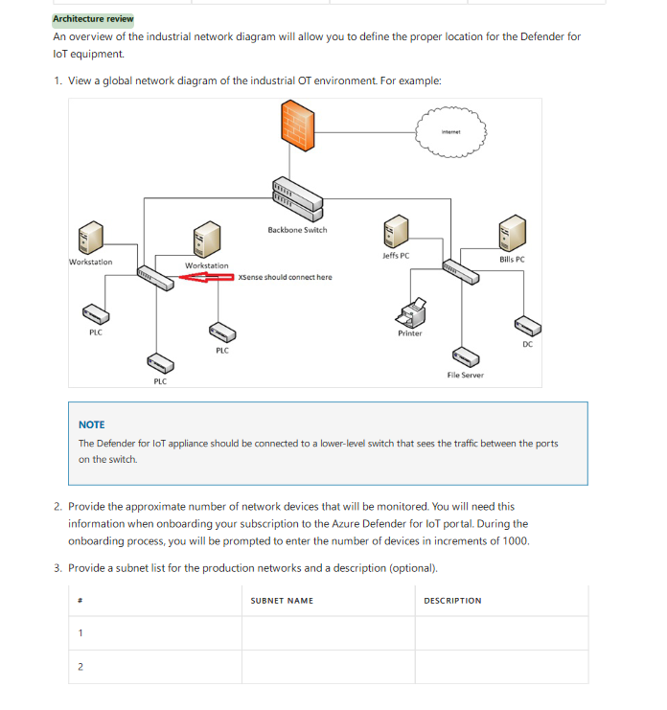
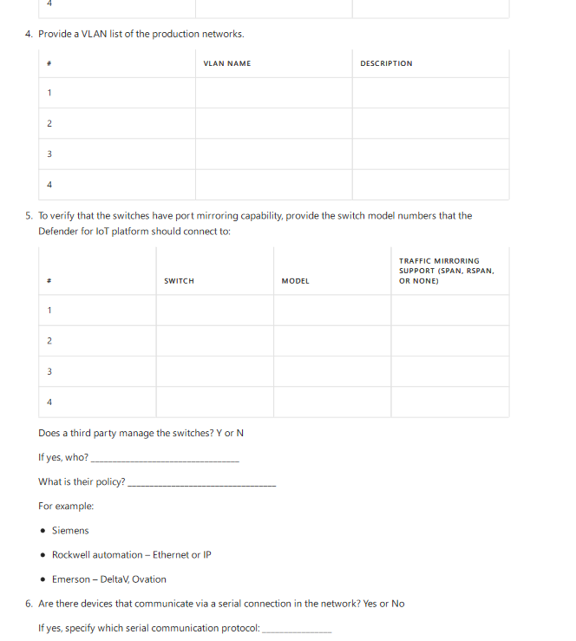
1. Identify the solution Infrastructure
Architecture review discovery questions Azure Defender for IoT - Network Setup Guide, appendix 2
Network Diagram review – where to connect
Estimated number of assets in the NW
List of subnets, VLANS
Switch models – managed for port mirroring
List of vendors and OT protocols
Notes:
1. Important to have some understanding of the OT network
2. Estimate number of total assets that will be monitored
3. Determine subnets and VLANS that will be monitored
4. Switch model numbers are used to determine capabilities of the switches re: mirroring
5. Compare list of vendors and protocols against supported list

Slide 8
1. Network overview
Guiding questions:
If we connect to this switch, will we see communication between the HMI and the PLCs?
What is the physical distance between switches?
Fiber or Copper
If switch is unmanaged could we use network TAP?
Physical rack space for the ID4IoT collector in that cabinet?
Who manages the switches (external? IT?)
Internet
Backbone Switch
Workstation
Workstation
Jeffs PC
Bills PC
Sensor should connect here
PLC
Printer
PLC
DC
PLC
File Server
Network architecture review with network and operational engineers will set expectations and define where is the best place to connect AD4IoT collector
Notes:
First question is really important and will determine success or failure

Slide 9
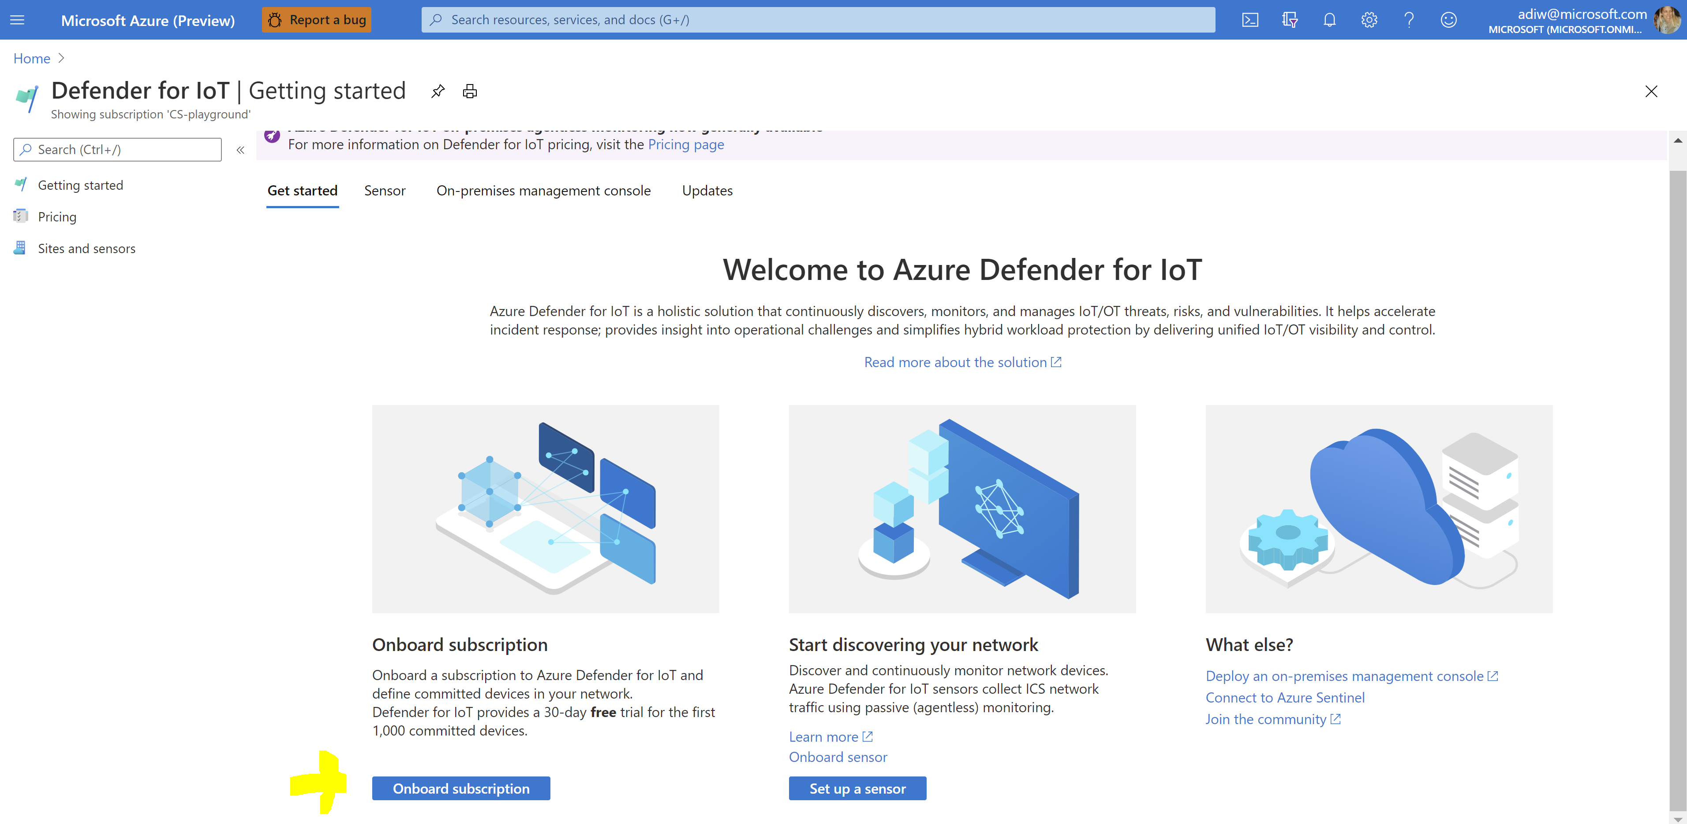
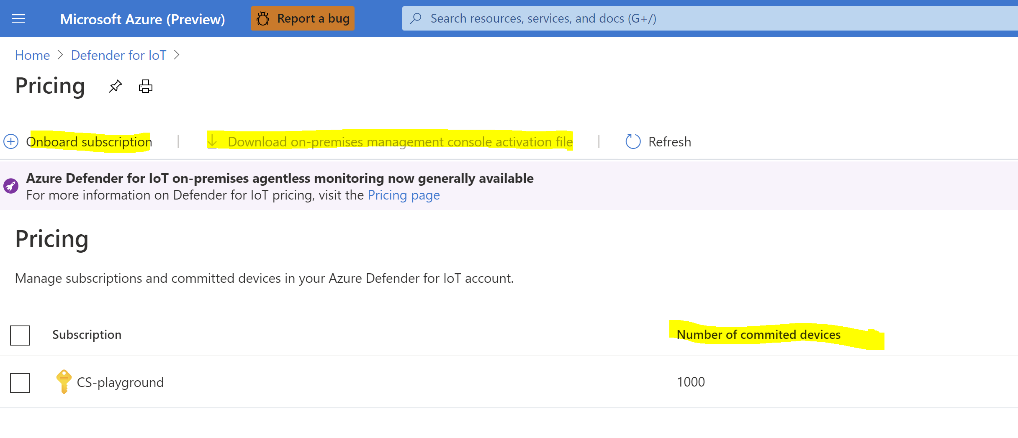
2. Register with Azure Defender for IoT
On board your Azure subscriptions to Defender for IoT
Go to the Azure Defender for IoT portal
Select Azure Defender for IoT
Select Onboard subscription
On board your Azure subscriptions to Defender for IoT
On the Pricing page, select or create a subscription
Add the number of committed devices
Download an activation file for the on-premises management console

Slide 10
2. Permissions
Administrative user permissions are required to register and activate the sensor and management
The following table describes user access permissions to Azure Defender for IoT service in Azure portal
Permission | Security reader | Security administrator | Subscription contributor | Subscription owner
View all Defender for IoT screens and data | ✓ | ✓ | ✓ | ✓
On board a sensor |  | ✓ | ✓ | ✓
Update pricing |  | ✓ | ✓ | ✓
Recover password | ✓ | ✓ | ✓ | ✓

Slide 11
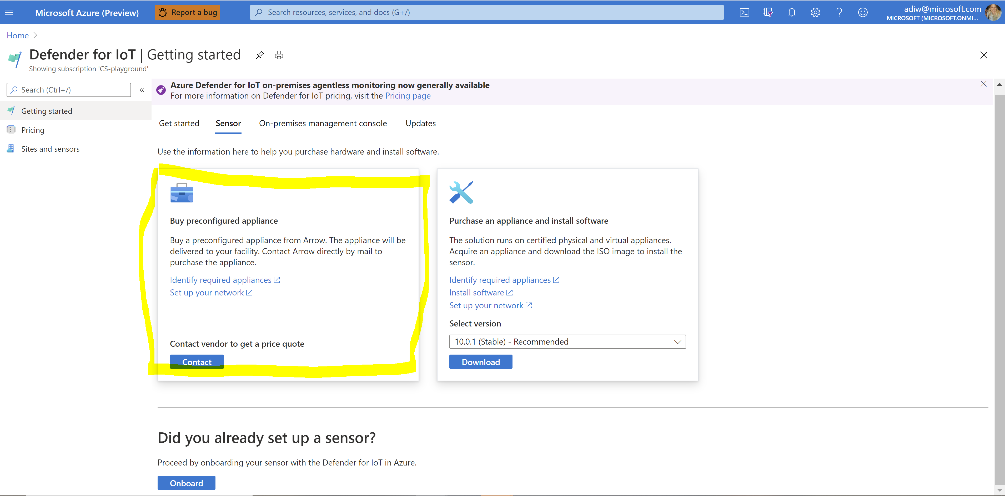
3. Preparations & Configurations
HW Order (OPM, Sensor) – Local / Installed and preconfigured
SPAN port or TAP configuration
Allocate a static IP (default GW, DNS, mask) for each sensor
Firewall rules configuration:
For collector and OPM (On Premise Manager) console interface: SSL connection, port 443
For troubleshooting purposes, it is recommended to allow SSH, port 22
The connection between collector platform/ OPM platform to an NTP server is over NTP UDP port 123
The connection between collector platform/ OPM platform and the mail server (if relevant) is over SMTP port 25
The connection between collector platform/ OPM platform and the DNS (if relevant) is over port 53
The connection between collector platform/ OPM platform to the centralized logging system (if relevant) is over your defined port
The connection between collector platform/ OPM platform to the Active Directory (if relevant) is over your defined LDAP/S port (for example TCP 389).
SNMP/MIB keep-alive monitoring -prerequisite to this is to open port UDP 161 in the FW
Windows Endpoint Monitoring (WMI) - prerequisite for this is to configure a firewall rule that opens outgoing traffic from Sensor to the scanned subnet using UDP port 135 and all TCP ports above 1024.
For cloud connected - verify that *.azure-devices.net: TCP port: 443 (IOT hub access) is opened to the firewall or proxy
Notes:
SPAN port Configuration -
Prior to CyberX installation, it is required to prepare the environment for mirroring,
Make sure that the switch that CyberX will be connected to have an ability to mirror traffic:
configure “only RX” SPAN/RSPAN port mirroring option and choose a port that will be connected to XSense as a destination
Note: The mirroring option is disabled by default in the majority of switches
2. Allocate Static IP for CyberX appliance(s) console / monitoring interface
3. Firewall rules configuration - XSense have a dedicated management port that connects to the customer network,

Slide 12
3. Preparations & Configurations
HW Order (OPM, Sensor) – Local / Installed and preconfigured
SPAN port or TAP configuration
Allocate a static IP (default GW, DNS, mask) for each sensor
Firewall rules configuration:
For collector and OPM (On Premise Manager) console interface: SSL connection, port 443
For troubleshooting purposes, it is recommended to allow SSH, port 22
The connection between collector platform/ OPM platform to an NTP server is over NTP UDP port 123
The connection between collector platform/ OPM platform and the mail server (if relevant) is over SMTP port 25
The connection between collector platform/ OPM platform and the DNS (if relevant) is over port 53
The connection between collector platform/ OPM platform to the centralized logging system (if relevant) is over your defined port
The connection between collector platform/ OPM platform to the Active Directory (if relevant) is over your defined LDAP/S port (for example TCP 389).
SNMP/MIB keep-alive monitoring -prerequisite to this is to open port UDP 161 in the FW
Windows Endpoint Monitoring (WMI) - prerequisite for this is to configure a firewall rule that opens outgoing traffic from Sensor to the scanned subnet using UDP port 135 and all TCP ports above 1024.
For cloud connected - verify that *.azure-devices.net: TCP port: 443 (IOT hub access) is opened to the firewall or proxy
Notes:
SPAN port Configuration -
Prior to CyberX installation, it is required to prepare the environment for mirroring,
Make sure that the switch that CyberX will be connected to have an ability to mirror traffic:
configure “only RX” SPAN/RSPAN port mirroring option and choose a port that will be connected to XSense as a destination
Note: The mirroring option is disabled by default in the majority of switches
2. Allocate Static IP for CyberX appliance(s) console / monitoring interface
3. Firewall rules configuration - XSense have a dedicated management port that connects to the customer network,

Slide 13
Validation – PCAP Recording
Sample of recorded traffic (PCAP file) would allow:
Validation of switch configuration
Expected traffic is monitored (OT traffic)
Identify bandwidth and estimated number of devices
Recording a sample PCAP file (few minutes) can be done by connecting customer’s laptop with Wireshark application to configured SPAN port

Slide 14
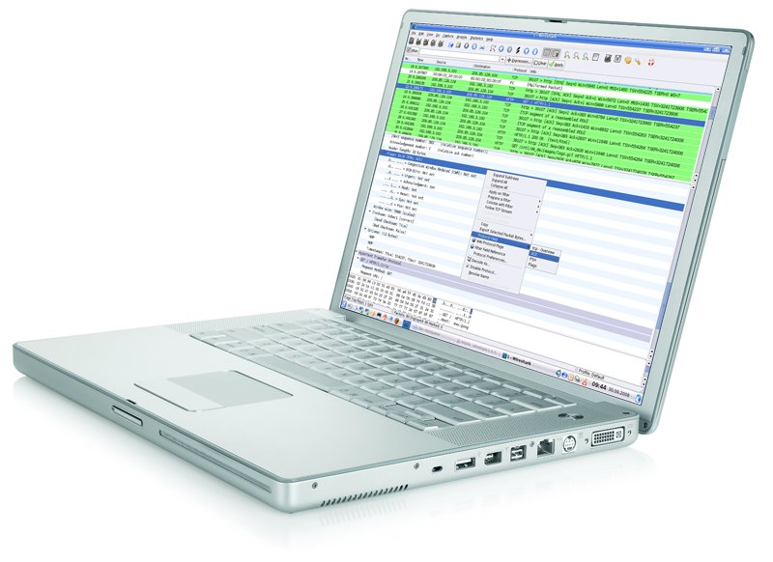
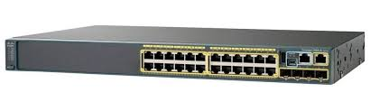

Validation
A. PCAP Recording
Sample of recorded traffic (PCAP file) would allow:
Validation of switch configuration
Expected traffic is monitored (OT traffic)
Identify bandwidth and estimated number of devices
Recording a sample PCAP file (few minutes) can be done by connecting customer’s laptop with Wireshark application to configured SPAN port

Slide 15
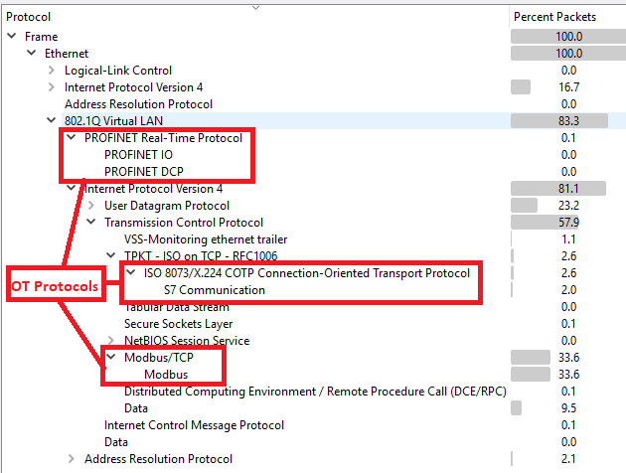
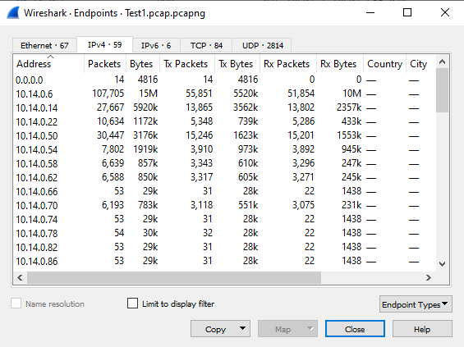
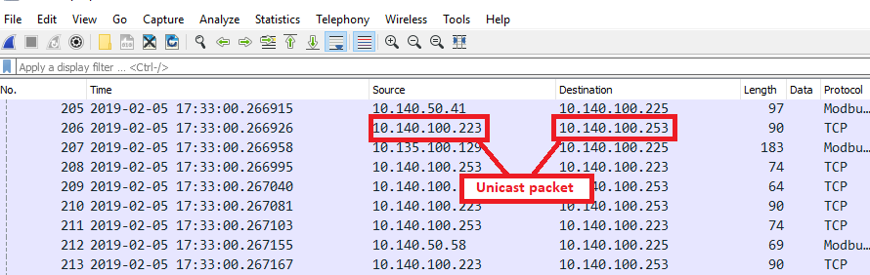
Validation – PCAP Analysis
Verify Unicast communication between static IPs
Via Statistics -> Protocol Hierarchy Verify that recorded traffic contains industrial OT protocols
Via Statistics -> Endpoints Get approximate number of devices
Notes:
CLICK IN SLIDE MODE TO START ANIMATION
Wireshark, statistics – Endpoints, for count of devices

Slide 16
Validation
B. PCAP Analysis
Verify Unicast communication between static IPs
Via Statistics -> Protocol Hierarchy Verify that recorded traffic contains industrial OT protocols
Via Statistics -> Endpoints Get approximate number of devices
Notes:
CLICK IN SLIDE MODE TO START ANIMATION
Wireshark, statistics – Endpoints, for count of devices

Slide 17
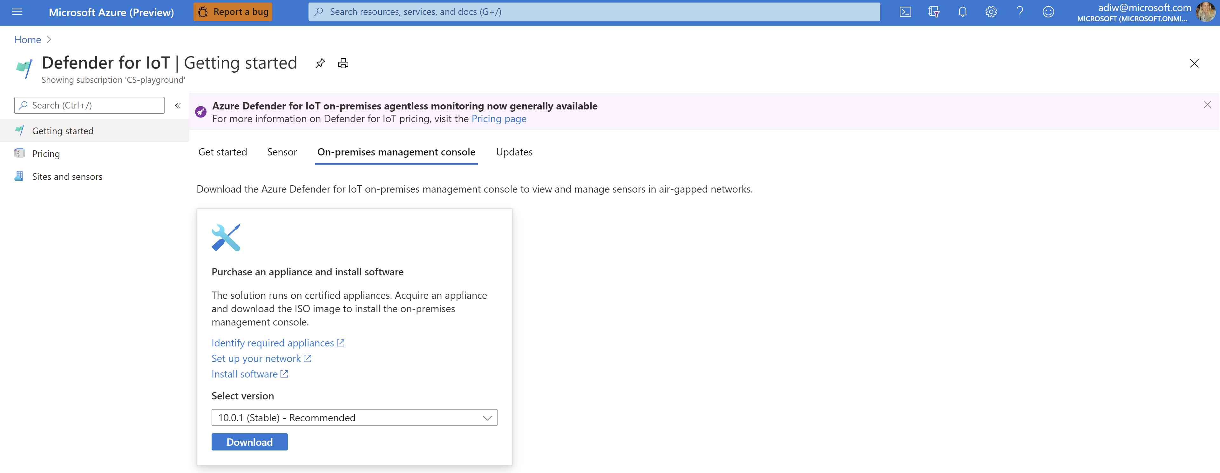
4. Install and set up the on-premises management console
Once you acquire your on-premises management console appliance:
Download the ISO package from the Azure Defender for IoT portal
Select Getting Started from the Defender for IoT portal.
Select the On-premises management console tab.
Choose a version and select Download.
Install the software
Refer to Defender for IoT installation
Activate and carry out initial management console setup
Refer to Activate and set up your on-premises management console

Slide 18
4. Install and set up the on-premises management console
Once you acquire your on-premises management console appliance:
Download the ISO package from the Azure Defender for IoT portal
Select Getting Started from the Defender for IoT portal.
Select the On-premises management console tab.
Choose a version and select Download.
Install the software
Refer to Defender for IoT installation
Activate and carry out initial management console setup
Refer to Activate and set up your on-premises management console

Slide 19
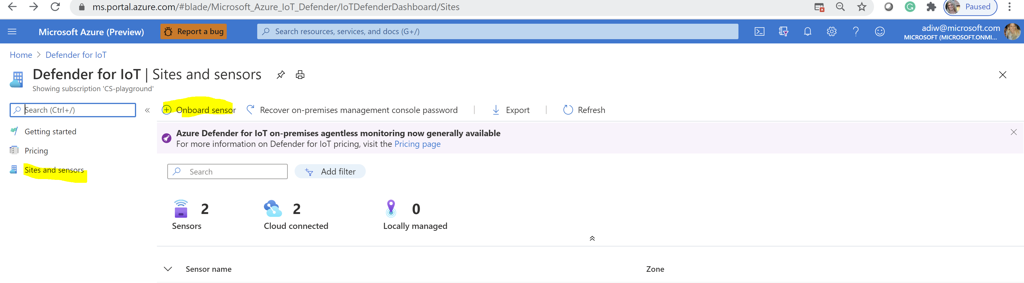
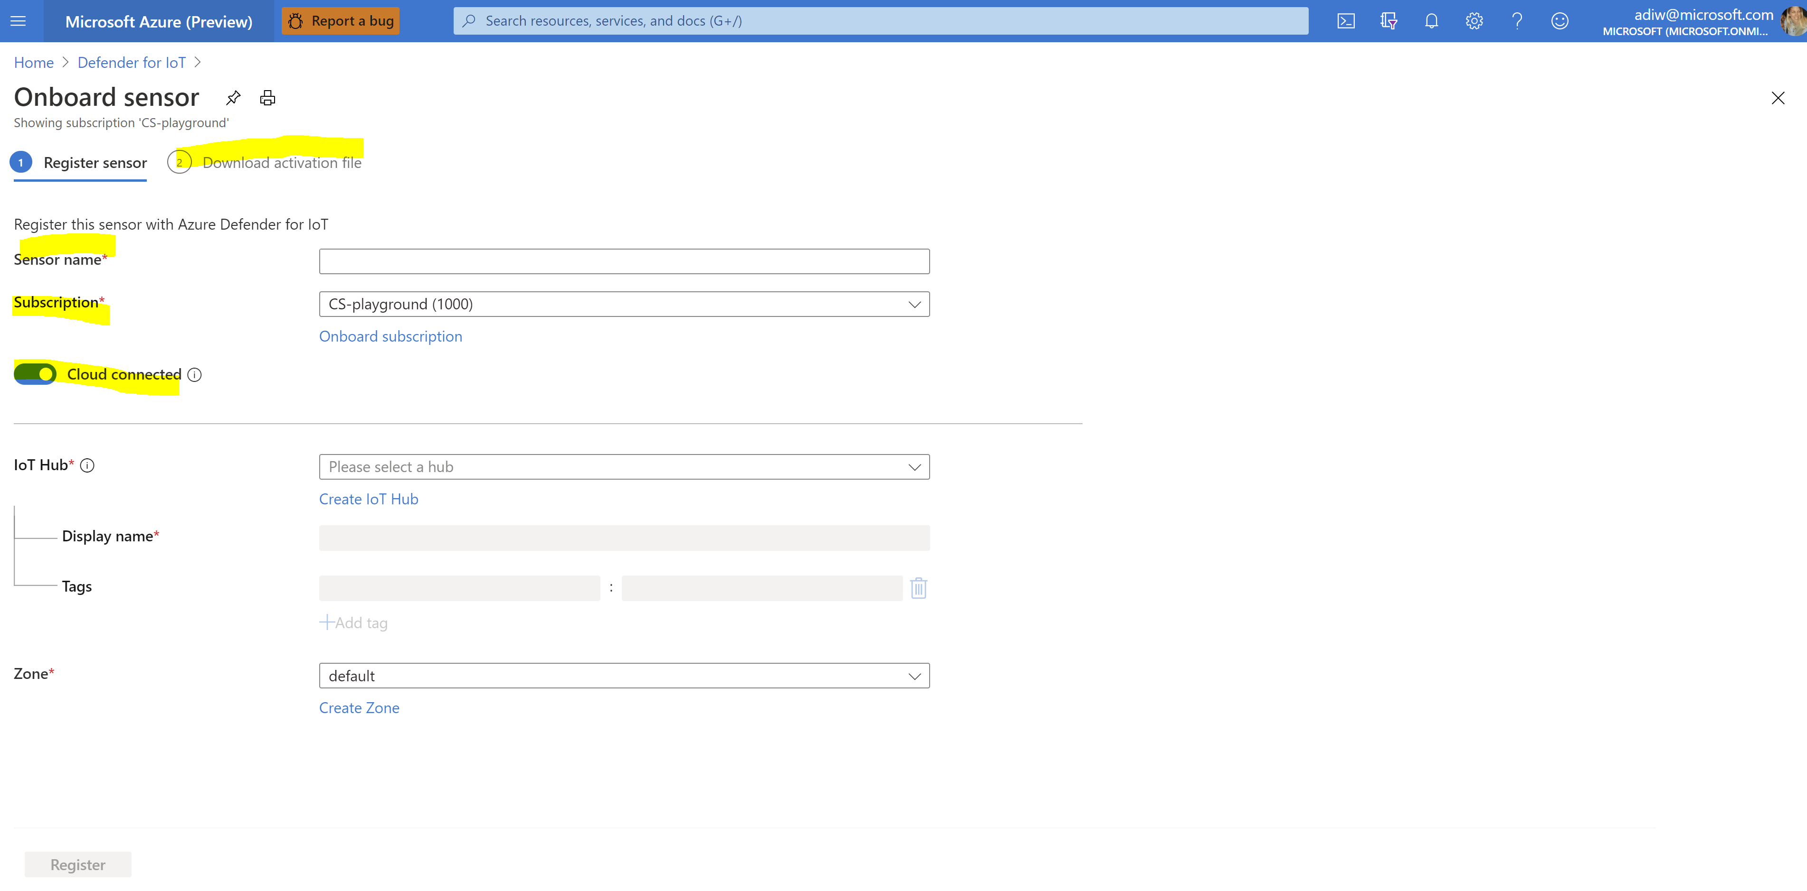
5. On board a sensor to Azure portal
On board a sensor by registering it with Azure Defender for IoT and downloading a sensor activation file:
Option 1 - Cloud connected
Detection insights are displayed in the sensor console
Alert information is delivered through an IoT hub and can be shared with other Azure services, such as Azure Sentinel.
Option 2 - Locally managed
Detection insights are displayed in the sensor console.
If you're working in an air-gapped network and want a unified view of all information detected by multiple locally managed sensors, work with the on-premises management console.
Download a sensor activation file

Slide 20
5. Onboard a sensor to Azure portal
Onboard a sensor by registering it with Azure Defender for IoT and downloading a sensor activation file:
1. Define a sensor name and associate it with a subscription (Sites and sensors -> Onboard a sensor)
Option 1 - Cloud connected
Detection insights are displayed in the sensor console
Alert information is delivered through an IoT hub and can be shared with other Azure services, such as Azure Sentinel.
Option 2 - Locally managed
Detection insights are displayed in the sensor console.
If you're working in an air-gapped network and want a unified view of all information detected by multiple locally managed sensors, work with the on-premises management console.
3. Download a sensor activation file.

Slide 21
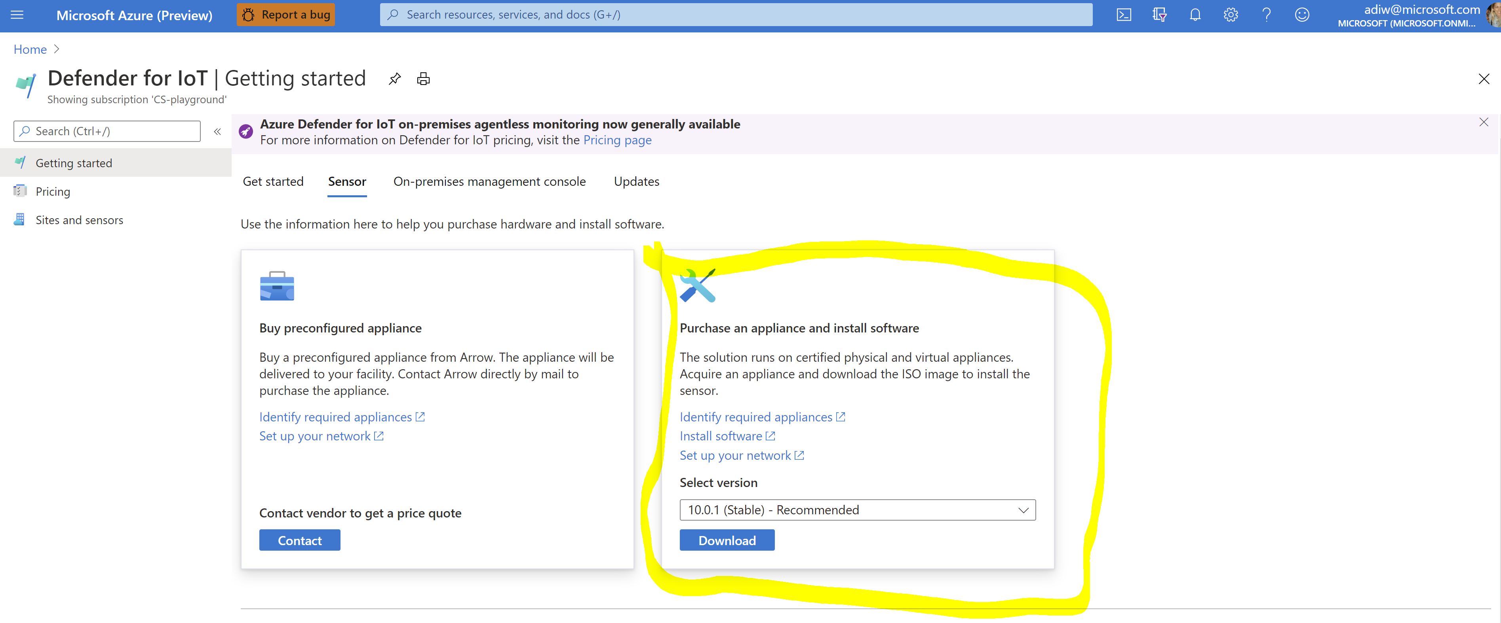
6. Deployment - Install the sensor
… *If not preconfigured
Download the ISO package from the Azure Defender for IoT portal, install the software:
Select Getting Started from the Defender for IoT portal.
Select Set up sensor.
Choose a version and select Download.
Install the sensor software. Refer to Defender for IoT installation manual.
*Microsoft has partnered with Arrow to provide preconfigured sensors. To purchase a preconfigured sensor, contact Arrow at the following address: hardware.sales@arrow.com

Slide 22
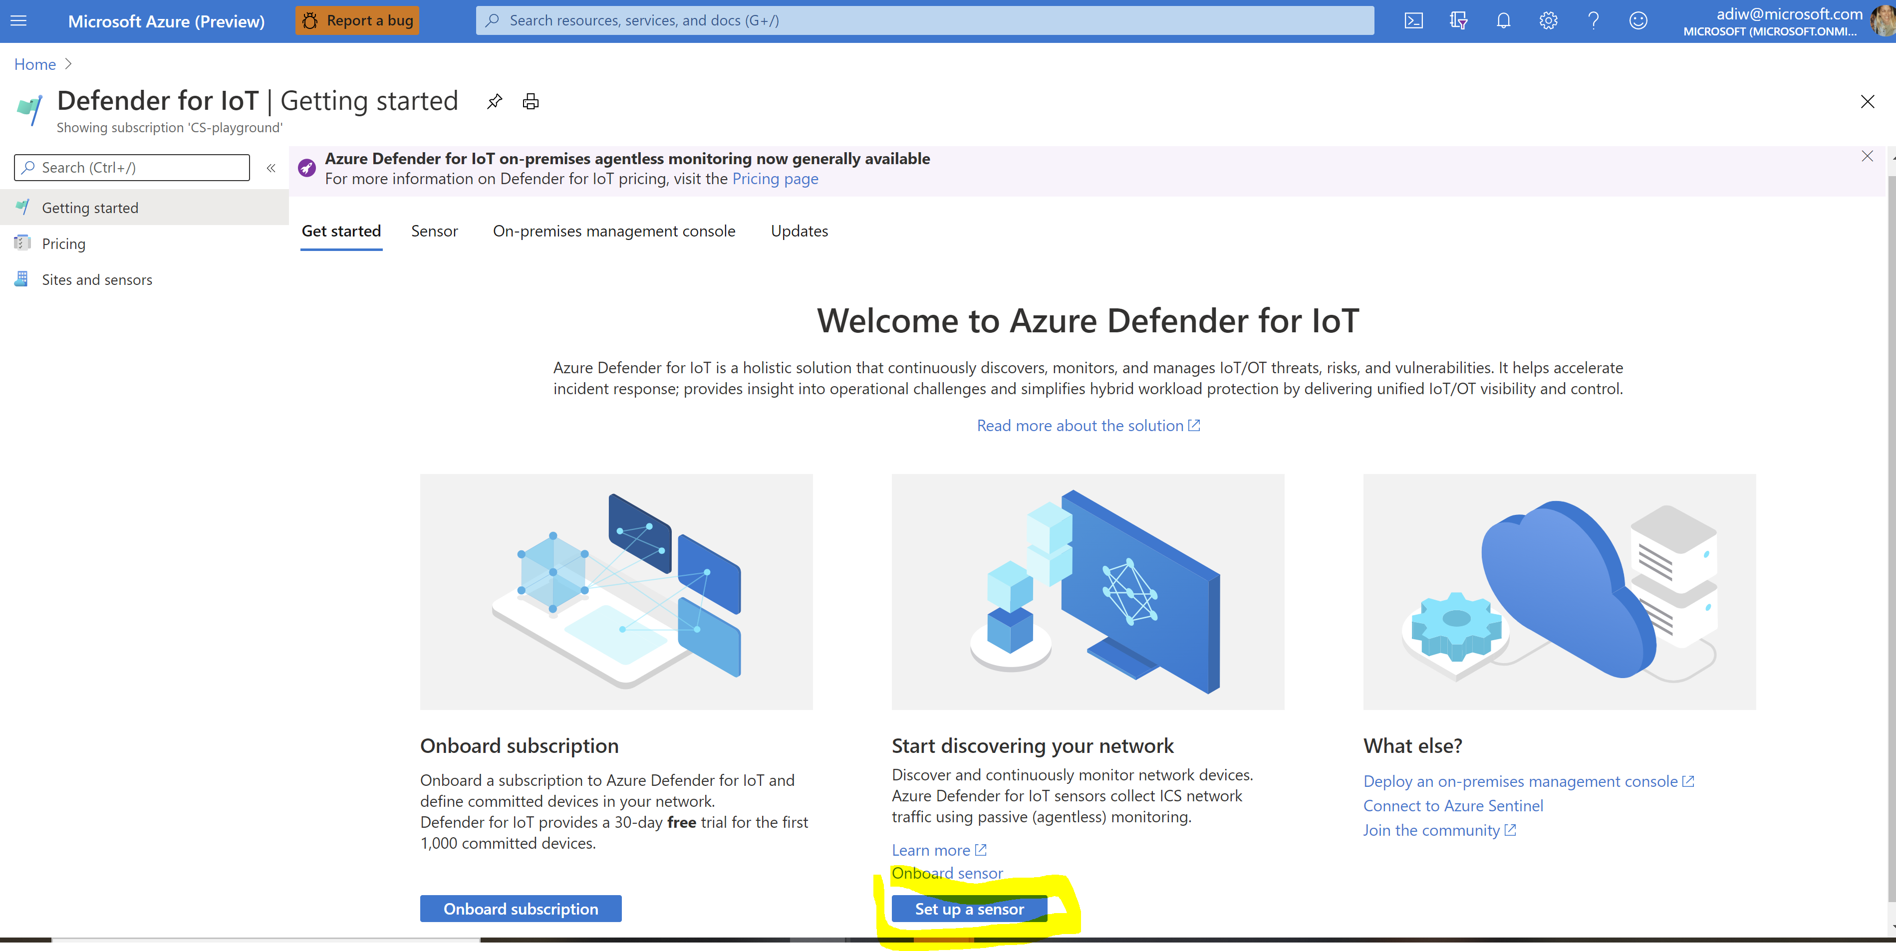
6. Deployment - Install the sensor … *If not preconfigured
Download the ISO package from the Azure Defender for IoT portal, install the software:
1. Select Getting Started from the Defender for IoT portal.
2. Select Set up sensor.
3. Choose a version and select Download.
4. Install the sensor software. refer to Defender for IoT installation manual
*Microsoft has partnered with Arrow to provide preconfigured sensors. To purchase a preconfigured sensor, contact Arrow at the following address: hardware.sales@arrow.com

Slide 23
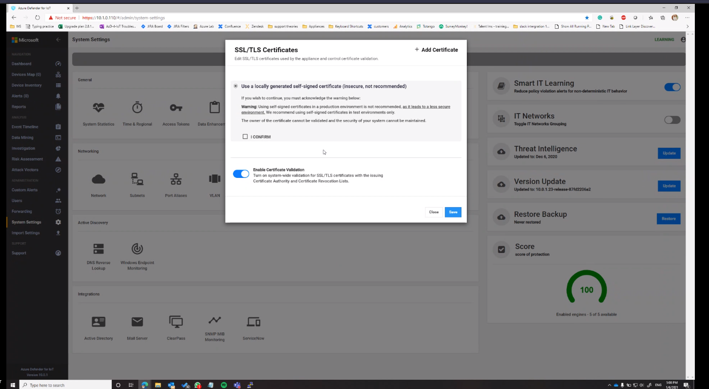

6. Deployment – prerequisites
Before signing into the sensor console, administrator users should have access to:
User sign-in credentials for the sensor.
If you downloaded an ISO for the sensor, use the default credentials that you received during the installation. We recommend that you create a new Administrator user after activation.
If you purchased a preconfigured sensor from Arrow, you need to generate a password when signing in for the first time on Azure site.
The activation file associated with this sensor. The file was generated and downloaded during sensor onboarding on the Defender for IoT portal.
An SSL/TLS CA-signed certificate that your company requires.
Two levels of security are available:
Meet specific certificate and encryption requirements requested by your organization by uploading the CA-signed certificate.
Allow validation between the management console and connected sensors. This option is enabled by default after installation.
Notes:
The console supports the following certificate types:
Private and Enterprise Key Infrastructure (private PKI)
Public Key Infrastructure (public PKI)
Locally generated on the appliance (locally self-signed)
[IMPORTANT] We recommend that you don't use the default self-signed certificate. The certificate is not secure and should be used for test environments only. The owner of the certificate can't be validated, and the security of your system can't be maintained. Never use this option for production networks.

Slide 24
6. Deployment – prerequisites
Before signing in to the sensor console, administrator users should have access to:
User sign-in credentials for the sensor.
If you downloaded an ISO for the sensor, use the default credentials that you received during the installation. We recommend that you create a new Administrator user after activation.
If you purchased a preconfigured sensor from Arrow, you need to generate a password when signing in for the first time on Azure site.
The activation file associated with this sensor. the file was generated and downloaded during sensor onboarding on the Defender for IoT portal.
An SSL/TLS CA-signed certificate that your company requires.
Two levels of security are available:
Meet specific certificate and encryption requirements requested by your organization
by uploading the CA-signed certificate.
Allow validation between the management console and connected sensors.
This option is enabled by default after installation
Notes:
The console supports the following certificate types:
Private and Enterprise Key Infrastructure (private PKI)
Public Key Infrastructure (public PKI)
Locally generated on the appliance (locally self-signed)
[IMPORTANT] We recommend that you don't use the default self-signed certificate. The certificate is not secure and should be used for test environments only. The owner of the certificate can't be validated, and the security of your system can't be maintained. Never use this option for production networks.

Slide 25
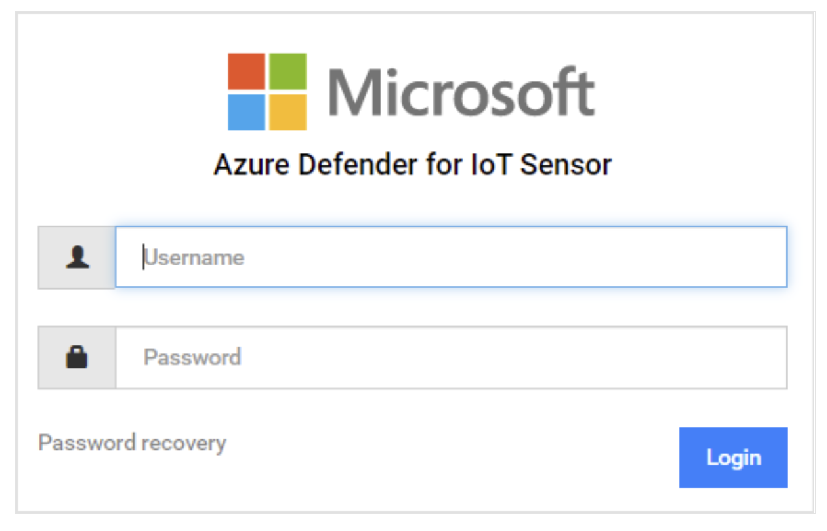
6. Deployment – On board to platform GUI
Connect the physical appliance via management port to LAN (allocated static IP)
Browse to the allocated static IP for login to Defender for IoT GUI
The sign-in dialog box opens:
MGMT Port
Traffic Input
Extension Card
iDRAC
Notes:
Normal management port shown
Extension card can add 4 more Traffic Input ports

Slide 26
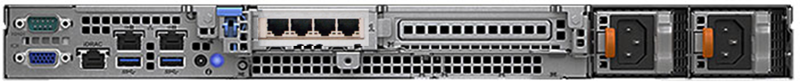
6. Deployment – On Board to platform GUI
MGMT
Port
Traffic
Input
Traffic
input
Extension
Card
iDRAC
Connect the physical appliance via management port to LAN (allocated static IP)
Browse to the allocated static IP for login to Azure Defender for IoT GUI
The sign-in dialog box opens:
Notes:
Normal management port shown
Extension card can add 4 more Traffic Input ports

Slide 27
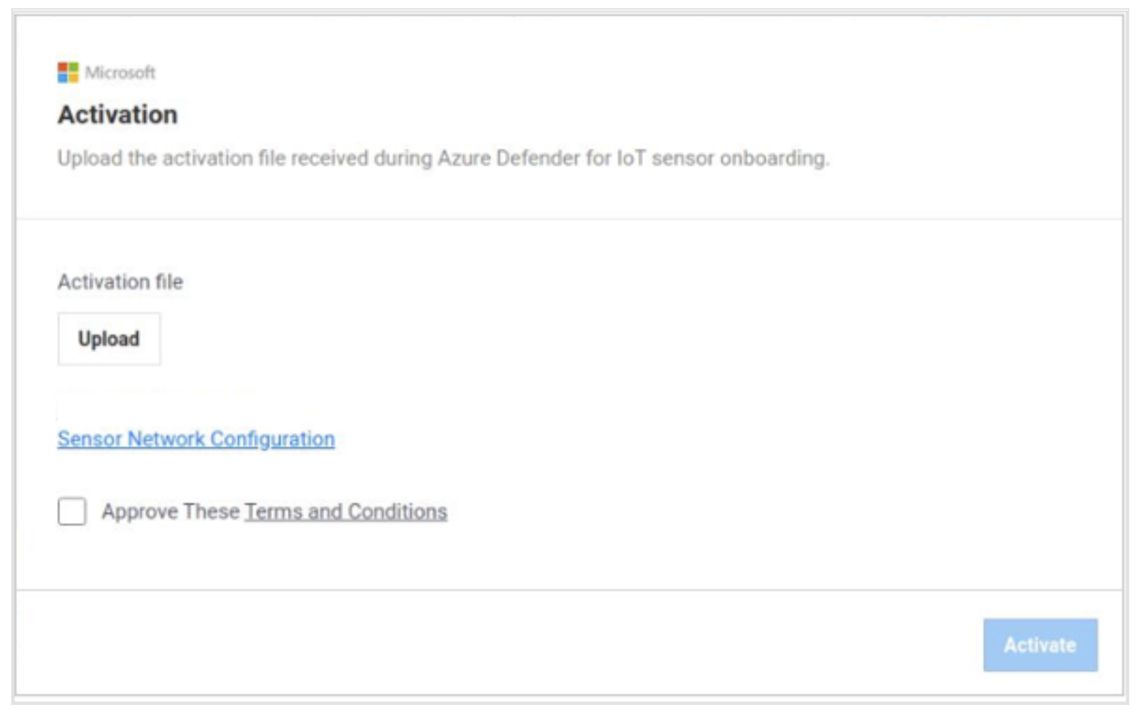
6. Deployment – Sign in and Activate
Enter the credentials defined during the sensor installation.
If you downloaded an ISO for the sensor, use the default credentials that you received during the installation. we recommend that you create a new Administrator user after activation
If you purchased a preconfigured sensor from Arrow, generate a password first (password recovery)
After you sign in, the Activation dialog box opens. Select Upload and go to the activation file that you downloaded during sensor onboarding.
Click the Sensor Network Configuration link if you want to change the sensor network configuration.
Accept the terms and conditions.
Select Activate. The SSL/TLS certificate dialog box opens.
Define a certificate name.
Upload the CRT and key files.
Enter a passphrase and upload a PEM file if required.

Slide 28
6. Deployment – Sign in and Activate
Enter the credentials defined during the sensor installation.
If you downloaded an ISO for the sensor, use the default credentials that you received during the installation. we recommend that you create a new Administrator user after activation
If you purchased a preconfigured sensor from Arrow, generate a password first (password recovery)
After you sign in, the Activation dialog box opens.
Select Upload and go to the activation file that you downloaded during sensor onboarding.
Click the Sensor Network Configuration link if you want to change the sensor network configuration
Accept the terms and conditions.
Select Activate. The SSL/TLS certificate dialog box opens.
Define a certificate name.
Upload the CRT and key files.
Enter a passphrase and upload a PEM file if required.

Slide 29
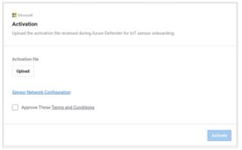
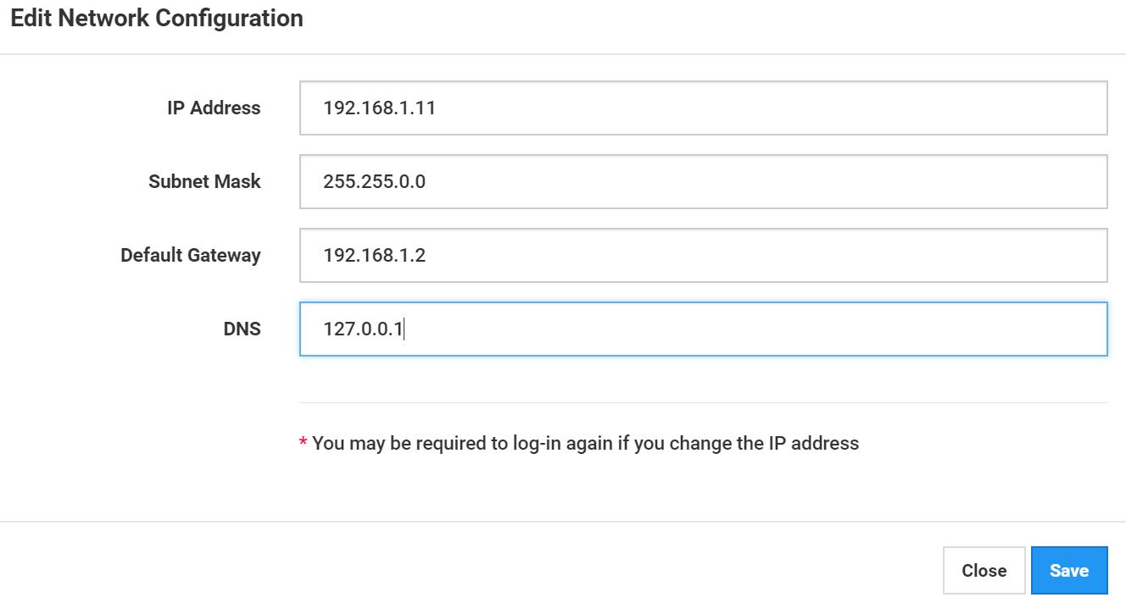
On boarding to GUI - in case Network Reconfigure required
Cross connect to management port (eno1) , type <* Default XSense_IP> in the browser.
Recover cyberx default password.
Activate the license.
Via System settings -> Network, reconfigure network properties (IP, Mask, Gateway).
Connect the management port to LAN and browse to the new static IP for login.
*Default XSense_IP> is visible on CLI once connecting monitor to the appliance, it is usually 10.100.100.1 or 192.168.1.10.
Traffic Input
iLO
MGMT Port

Slide 30
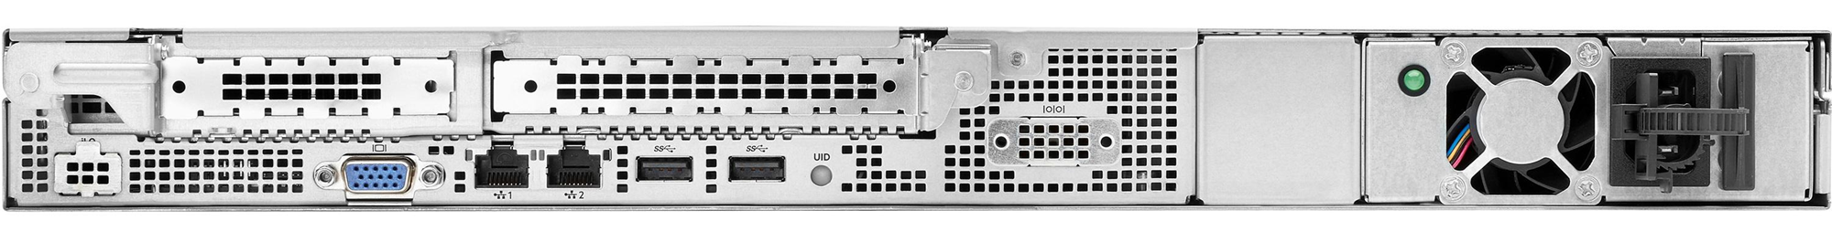



On boarding to GUI - in case Network Reconfigure required
Traffic
Input
Cross connect to management port (eno1) , type <* Default XSense_IP> in the browser
Recover cyberx default password
Activate the license
Via System settings -> Network, reconfigure network properties ( IP, Mask, Gateway)
Connect the management port to LAN and browse to the new static IP for login
iLO
Management Port
<*Default XSense_IP> is visible on CLI once connecting monitor to the appliance, it is usually 10.100.100.1 or 192.168.1.10

Slide 31
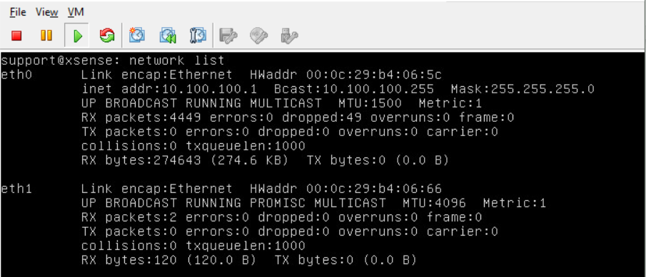
Troubleshooting
Cannot connect using Web interface
Verify that the computer that trying to connect is on the same network as the sensor.
Verify that the UI network is connected to the Management port on the sensor.
Ping the sensor IP address. If there is no Ping:
Connect a monitor (VGA port) and a keyboard to the sensor.
Use support user and password to login.
Use command network list to see the current IP address.
In case the network parameters are misconfigured, use the following procedure to change it:
Use command network edit-settings
Select “y” to change the management network IP address.
Select “y” to change the subnet mask.
Select “y” to change the DNS.
Select “y” to change the default gateway IP address.
Select “n” for the input interface change.
Select “y” to apply the settings.
After reboot, connect with support user and use the network list command to verify that the parameters were changed.
Try to ping and connect from web UI again.

Slide 32
Troubleshooting
Cannot connect using Web interface
Verify that the computer that trying to connect is on the same network as the sensor.
Verify that the UI network is connected to the Management port on the sensor.
Ping the sensor IP address. If there is no Ping:
Connect a monitor (VGA port) and a keyboard to the sensor.
Use support user and password to login.
Use command network list to see the current IP address.
In case the network parameters are misconfigured, use the following procedure to change it:
Use command network edit-settings
Select “y” to change the management network IP address.
Select “y” to change the subnet mask.
Select “y” to change the DNS.
Select “y” to change the default gateway IP address.
Select “n” for the input interface change.
Select “y” to apply the settings.
After reboot, connect with support user and use the network list command to verify that the parameters were changed.
Try to ping and connect from web UI again.

Slide 33
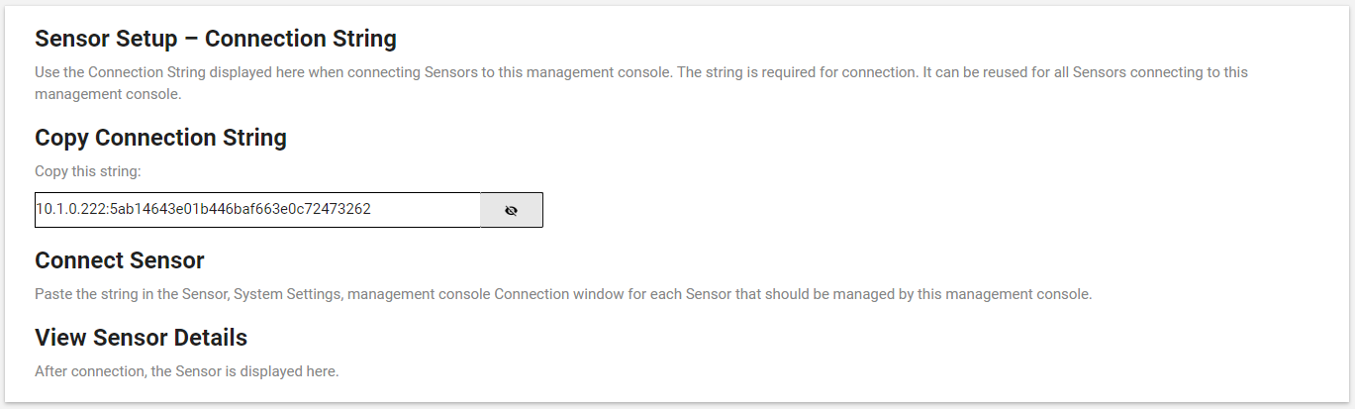
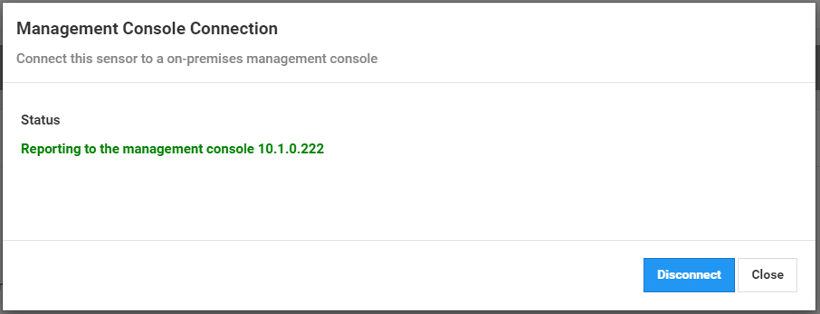
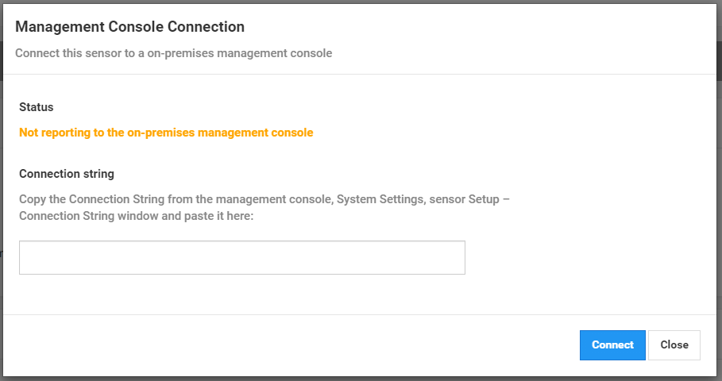
6. Deployment - Connect sensors to an on-premises management
Sensors send alert and device inventory information to the on-premises management console.
The on-premises management console can perform sensor backups, manage alerts that sensors detect, investigate sensor disconnections, and carry out other activity on connected sensors.
We recommend that you group multiple sensors monitoring the same networks in one zone. Doing this will coalesce information collected by multiple sensors.
Notes:
Get connection string from CM
Copy into sensor setup
Connect
Use magnifier

Slide 34
6. Deployment - Connect sensors to an on-premises management
Sensors send alert and device inventory information to the on-premises management console
The on-premises management console can perform sensor backups, manage alerts that sensors detect, investigate sensor disconnections, and carry out other activity on connected sensors
We recommend that you group multiple sensors monitoring the same networks in one zone. Doing this will coalesce information collected by multiple sensors.
Notes:
Get connection string from CM
Copy into sensor setup
Connect
Use magnifier

Slide 35
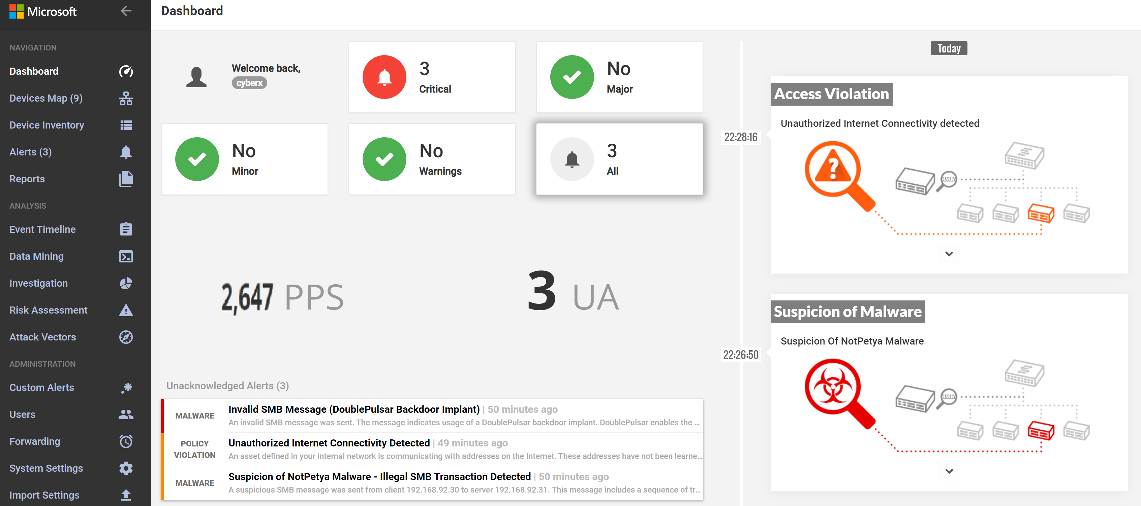
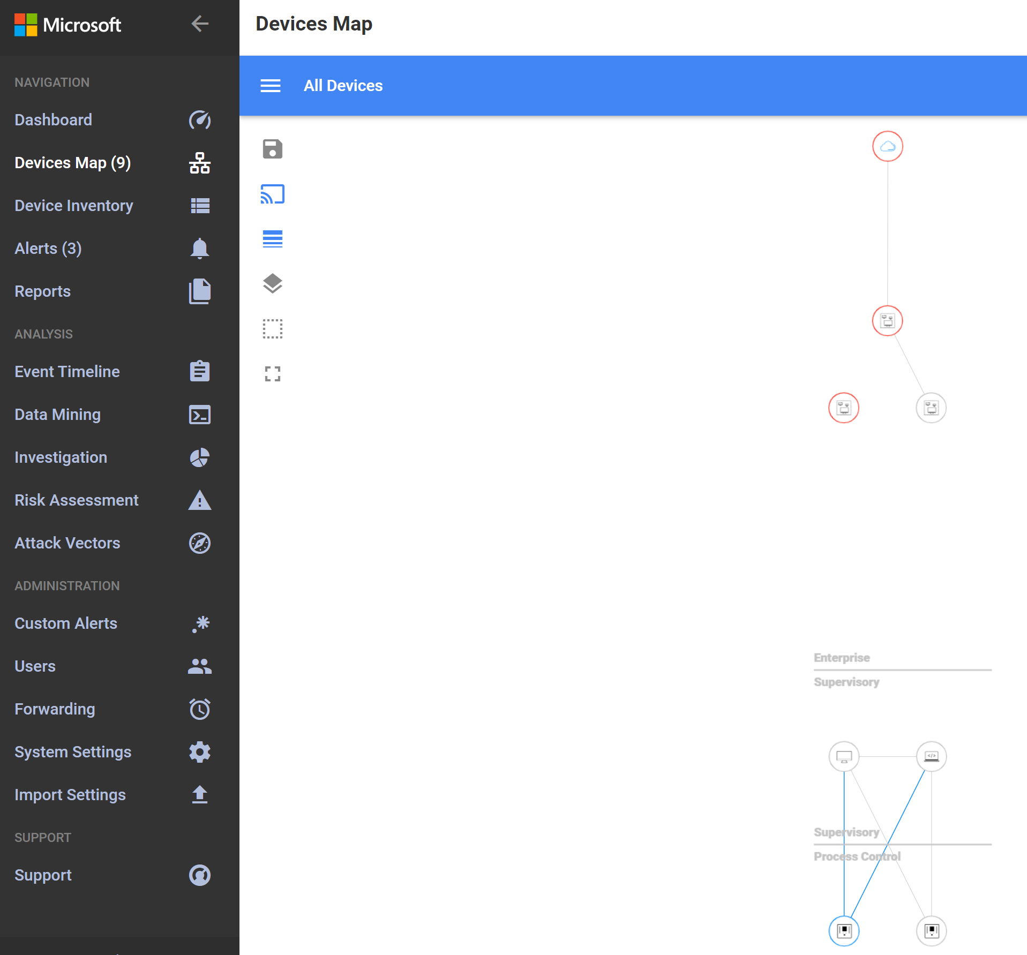
Deployment - Basic sanity checks
Dashboard:
PPS > 0
Assets:
Assets are discovered,
Unicast connections,
Expected monitored asset count
Notes:
How can you verify from GUI Xsense is up and running?

Slide 36
Deployment - Basic sanity checks
1. Dashboard :
PPS > 0
2. Assets :
Assets are discovered,
Unicast connections,
Expected monitored asset count
Notes:
How can you verify from GUI Xsense is up and running?

Slide 37
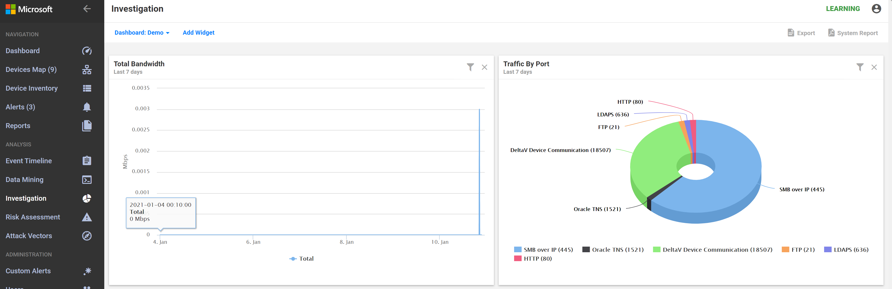
Deployment - Basic sanity checks
Via Investigation - create ‘Traffic by port’ and ‘Total Bandwidth’ widgets To verify Appliance is connected at correct place where OT traffic is being monitored
Notes:
Relevant traffic, BW sanity ( BW picks might indicate someone is downloading/stilling data or misconfiguration of certain asset, traffic by port shows the monitored protocols ( OT?)

Slide 38
Deployment - Basic sanity checks
3. Via Investigation - create ‘Traffic by port’ and ‘Total Bandwidth’ widgets
To verify Appliance is connected at correct place where OT traffic is being monitored
Notes:
Relevant traffic, BW sanity ( BW picks might indicate someone is downloading/stilling data or misconfiguration of certain asset, traffic by port shows the monitored protocols ( OT?)

Slide 39

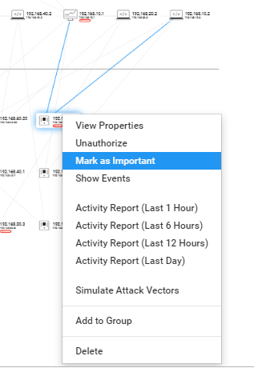
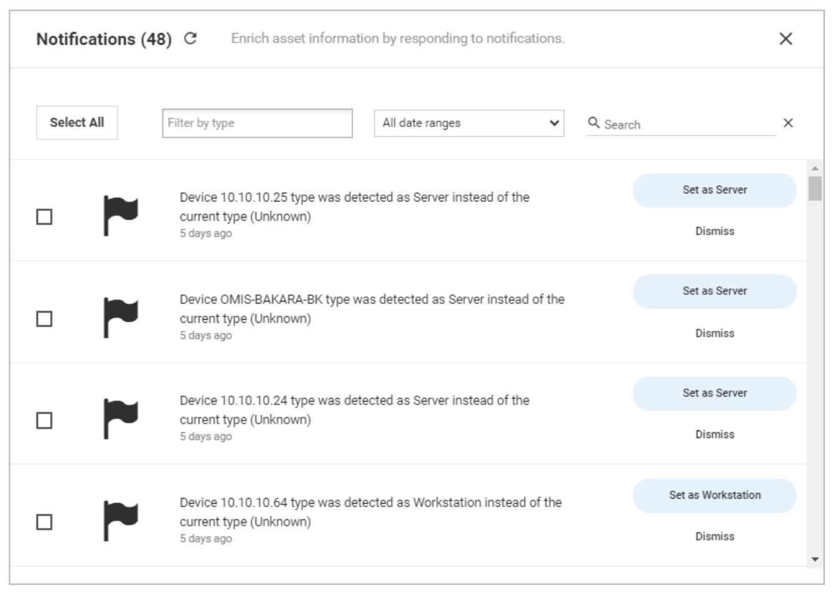
Configurations, fine Tuning, optimization
Assets, review and resolve notifications, mark important assets, create groups

Slide 40
Configurations, fine Tuning, optimization
Assets, review and resolve notifications, mark important assets, create groups

Slide 41
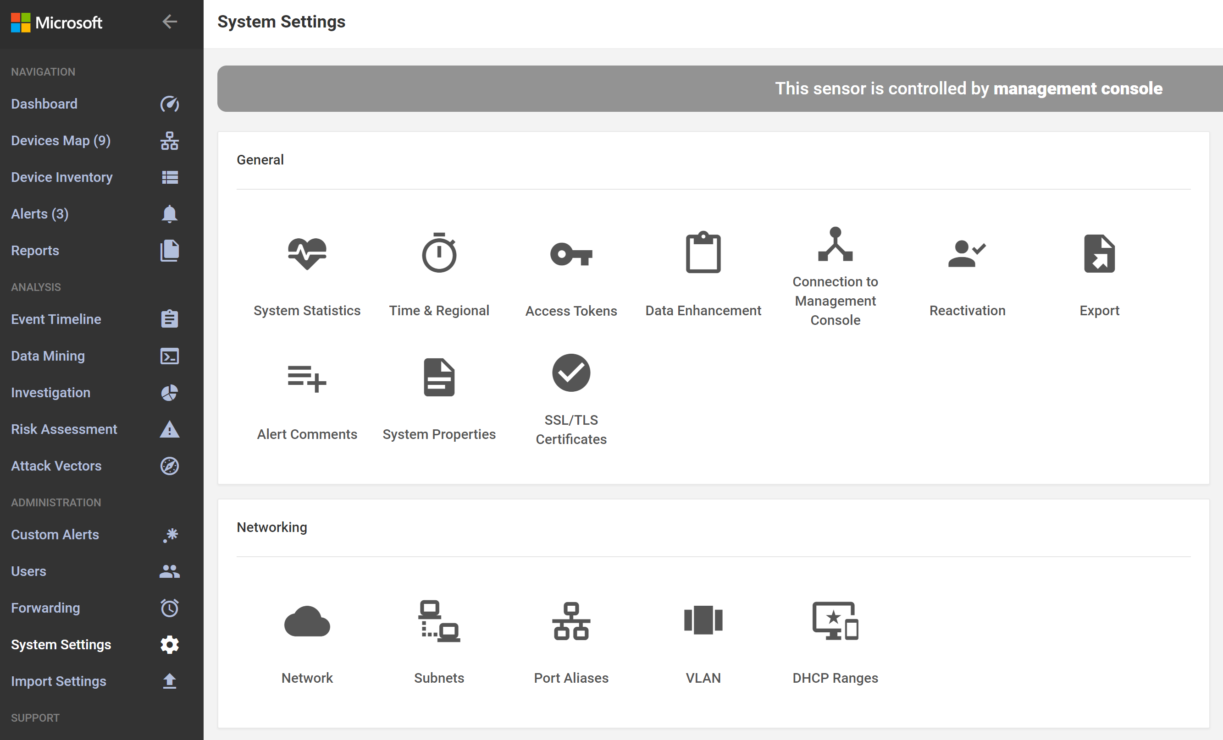
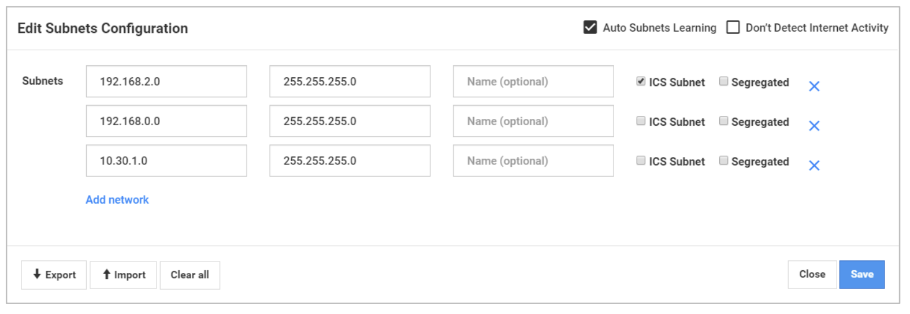
Configurations, fine Tuning, optimization
System settings -> subnets, define subnets and mark as ICS when relevant

Slide 42
Configurations, fine Tuning, optimization
2. System settings -> subnets, define subnets and mark as ICS when relevant

Slide 43
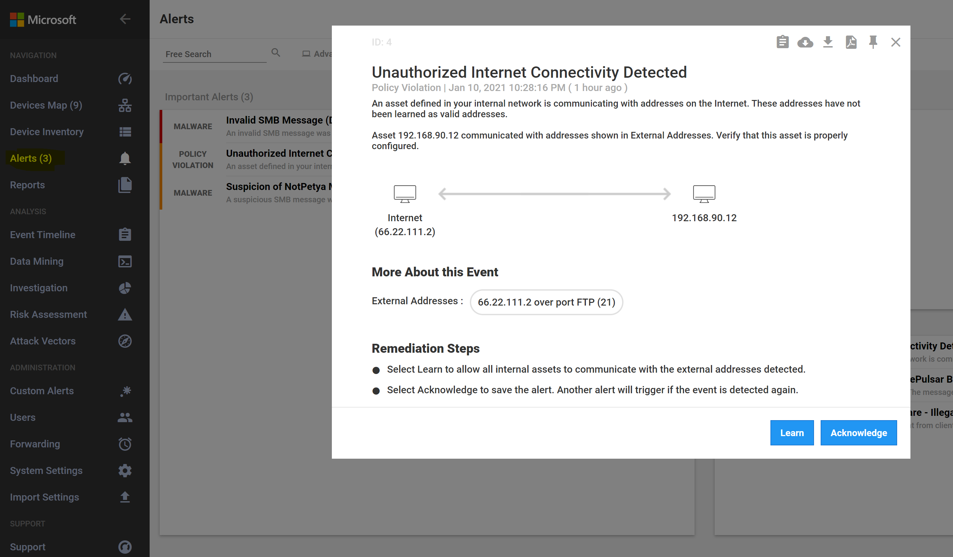
Configurations, fine Tuning, optimization
Alerts – review
Acknowledge
Learn (for policy violation) - add to baseline
Notes:
Option to download PCAP, PIN alert, export, go to assets view, create DM, view event log to farther investigate

Slide 44
Configurations, fine Tuning, optimization
3. Alerts - review
Acknowledge
Learn (for policy violation) - add to baseline
Notes:
Option to download PCAP, PIN alert, export, go to assets view, create DM, view event log to farther investigate

Slide 45
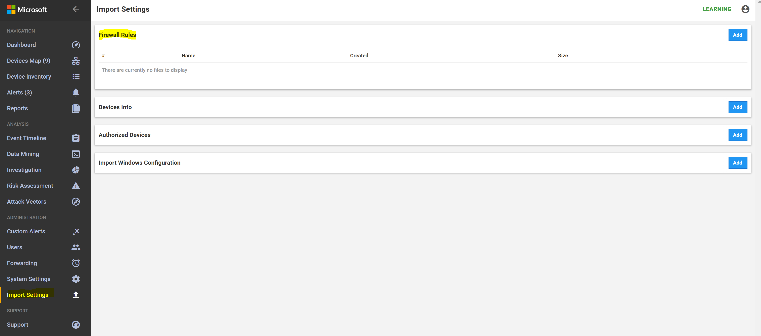
Configurations, fine Tuning, optimization
Import settings -> Firewall Rules * Supported firewalls: juniper, fortinet and checkpoint, upload the firewall export

Slide 46
Configurations, fine Tuning, optimization
4. Import settings -> Firewall Rules
* Supported firewalls: juniper, fortinet and checkpoint, upload the firewall export

Slide 47
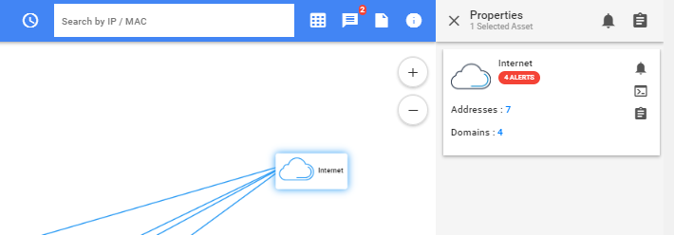
Asset detection - troubleshooting
Use case 1: Asset not discovered / asset count not as expected
Relevant Traffic is not monitored / span port misconfiguration
External addresses used as internal - appear as ‘internet cloud’
Use case 2: Asset type ‘unknown’
Relevant traffic is not monitored / asset is not communicating (i.e Switch not communicating using LLDP)
Span port misconfiguration
Partial supports for the relevant protocol
Use case 3: Asset type mis-identification
The asset didn't produce any traffic typical to assets of its nature ( /application not active)
Notes:
Use case 1: troubleshoot:
1. Go to Asset map verify number of expected assets
2. In case number of assets doesn’t match the expected:
2.1 Search for internet cloud - view properties - verify IP addresses - in case they are internal add them to system settings allowed addresses + subnets and delete from data mining internet connections report
2.2 Via CyberX GUI/ direct wireshark recording - Download alert PCAP, play PCAP at wireshark, search for any recording of the asset
Use case2:
1. Create data mining report ‘all’, per asset IP, compare reports of assets where type was identified vs. assets with unknown type. search for the differences between the reports
2. To verify the assumption that traffic was not recorded fully:
Play PCAP using wireshark and check if the Traffic for this asset is fully recorded. (switch config)
Use case 3
1. Verify all data enhancement / notifications are handled (Windows server 2008 => server, Windows 7 => workstation)
2. Go to Data Mining – create report ‘all’ - filter by asset IP - search for the relevant asset activity records (for example multicast / broadcast communication – is not enough to inspect asset type whereas OT protocols and commands – are enough to inspect the asset type)
3. Compare data mining reports between asset that was classified correctly vs. asset that was not (by creating a report per IP)
4. Request plant staff to force operation of the asset in the NW

Slide 48
Asset detection - troubleshooting
Use case 1: Asset not discovered / asset count not as expected
Relevant Traffic is not monitored / span port misconfiguration
External addresses used as internal - appear as ‘internet cloud’
Use case 2: Asset type ‘unknown’
Relevant traffic is not monitored / asset is not communicating (i.e Switch not communicating using LLDP)
Span port misconfiguration
Partial supports for the relevant protocol
Use case 3: Asset type mis-identification
The asset didn't produce any traffic typical to assets of its nature ( /application not active)
Notes:
Use case 1: troubleshoot:
1. Go to Asset map verify number of expected assets
2. In case number of assets doesn’t match the expected:
2.1 Search for internet cloud - view properties - verify IP addresses - in case they are internal add them to system settings allowed addresses + subnets and delete from data mining internet connections report
2.2 Via CyberX GUI/ direct wireshark recording - Download alert PCAP, play PCAP at wireshark, search for any recording of the asset
Use case2:
1. Create data mining report ‘all’, per asset IP, compare reports of assets where type was identified vs. assets with unknown type. search for the differences between the reports
2. To verify the assumption that traffic was not recorded fully:
Play PCAP using wireshark and check if the Traffic for this asset is fully recorded. (switch config)
Use case 3
1. Verify all data enhancement / notifications are handled (Windows server 2008 => server, Windows 7 => workstation)
2. Go to Data Mining – create report ‘all’ - filter by asset IP - search for the relevant asset activity records (for example multicast / broadcast communication – is not enough to inspect asset type whereas OT protocols and commands – are enough to inspect the asset type)
3. Compare data mining reports between asset that was classified correctly vs. asset that was not (by creating a report per IP)
4. Request plant staff to force operation of the asset in the NW

Slide 49
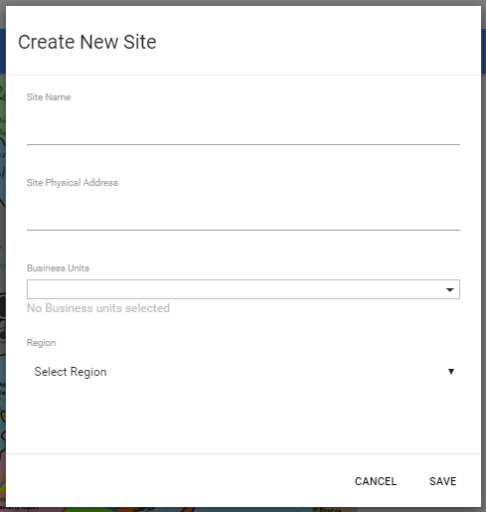
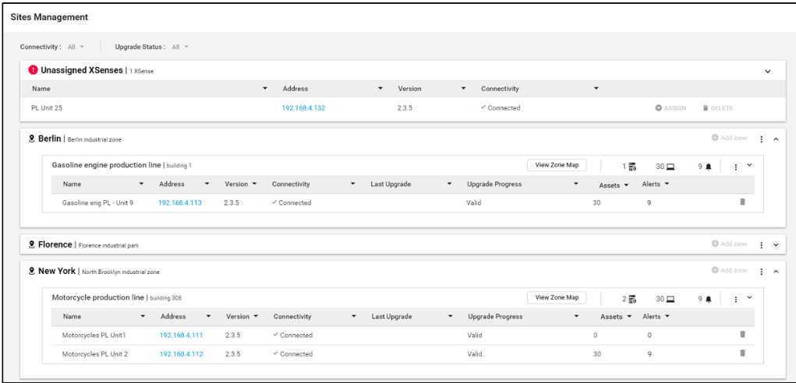
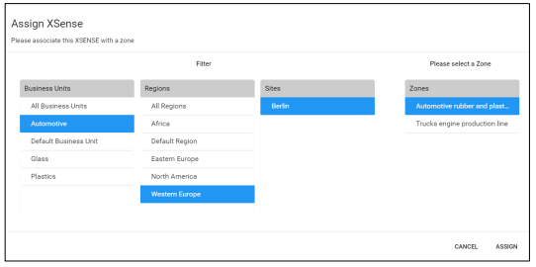
OPM - set up
Enterprise view -> create Site, select BU and region
Site management -> define Zones -> assign sensors (Assets which are monitored from different sensors in the same zone are deduped)

Slide 50

OPM - set up
7. Enterprise view -> create Site, select BU and region
8. Site management -> define Zones -> assign sensors (Assets which are monitored from different sensors in the same zone are deduped)

Slide 51
Business topology
Business units and regions are assigned to sites and zones
Region (Western Europe)
Automotive Business Unit
Glass
Business Unit
Plastic
Business Unit
Site 1
(Factory 1)
Site 2
(Factory 2)
Zone 1 (production line 1)
Zone 1 (production line 2)
Zone 1 (production line 3)
Sensor
Sensor
Sensor
Notes:
For each site you can define a business unit to reflect your organizational structure, a region and then add zones, which are logical entities in your network. For each zone you need to assign sensors.
The 5-level model provides the flexibility and granularity required to deliver the protection system that reflects the structure of your organization.
You can edit your sites directly from any of the map views. When opening a site from a map
view, the number of open alerts is shown next to each zone.
Mention that zones now may not be used in security

Slide 52
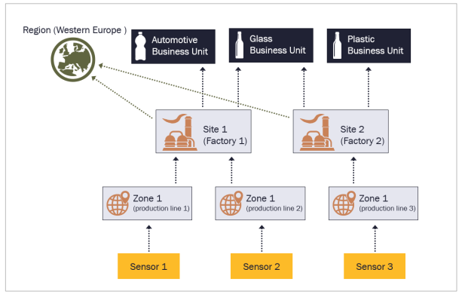
Business topology
Business units and regions are assigned to sites and zones
Notes:
For each site you can define a business unit to reflect your organizational structure, a region and then add zones, which are logical entities in your network. For each zone you need to assign sensors.
The 5-level model provides the flexibility and granularity required to deliver the protection system that reflects the structure of your organization.
You can edit your sites directly from any of the map views. When opening a site from a map
view, the number of open alerts is shown next to each zone.
Mention that zones now may not be used in security

Slide 53
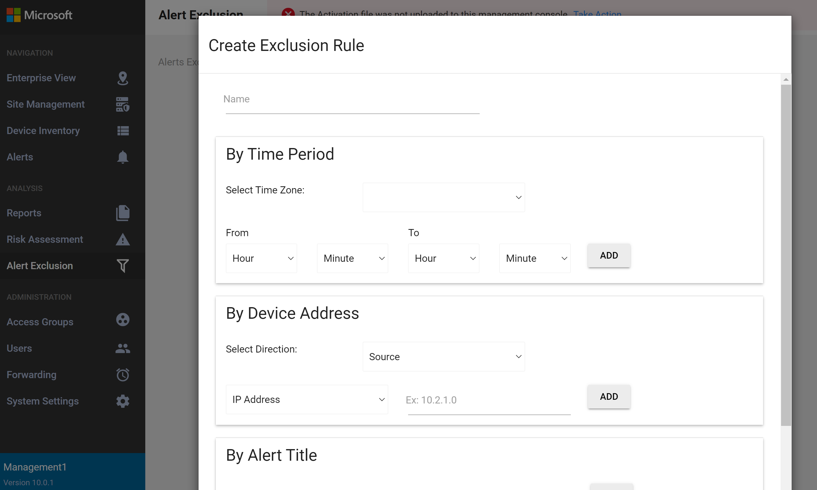
OPM - Define exclusion rules
Alert Exclusion -> create exclusion rule
To avoid unnecessary alerts, define:
Specific timeframe or 24/7 (00-23)
Specific device/s
Specific alert/s
Specific sensor/s
Note: The logic between conditions is AND

Slide 54
OPM - Define exclusion rules
Alert Exclusion -> create exclusion rule,
To avoid unnecessary alerts
Define:
Specific timeframe or 24/7 (00-23)
Specific device/s
Specific alert/s
Specific sensor/s
Note: The logic between conditions is AND

Slide 55
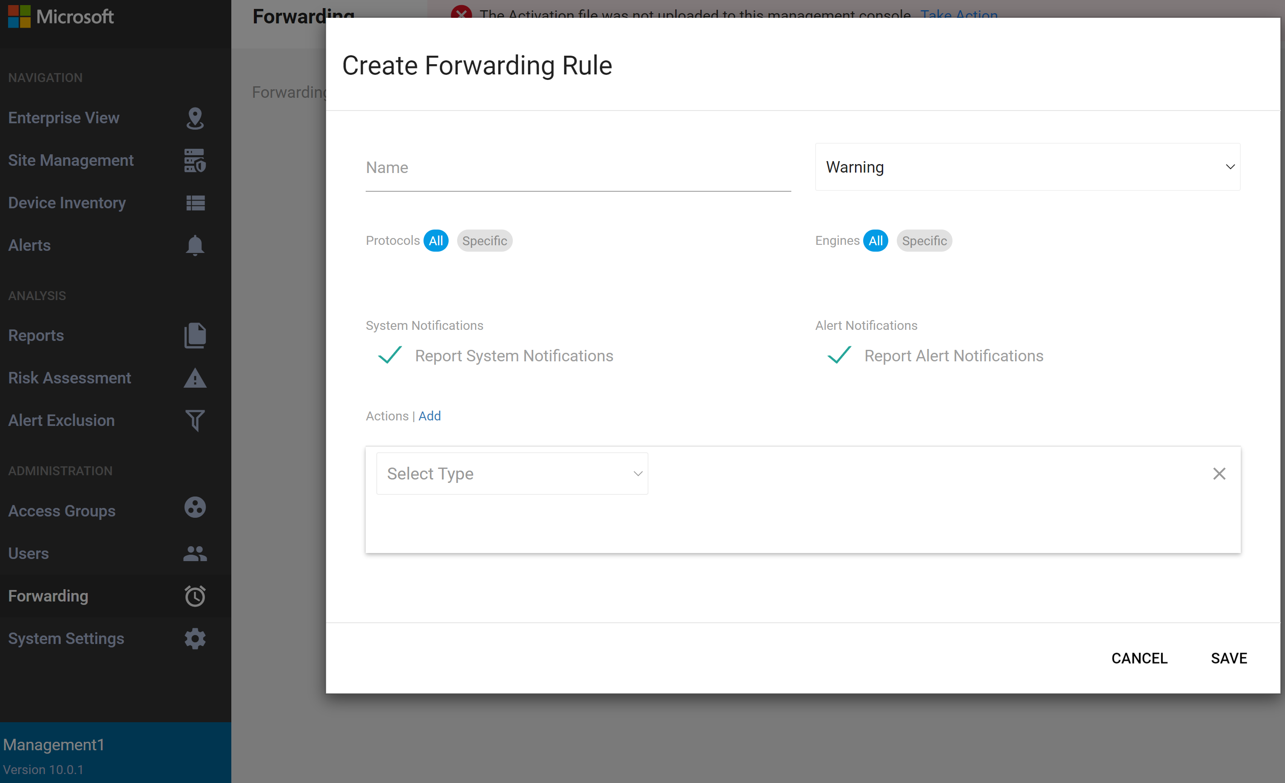
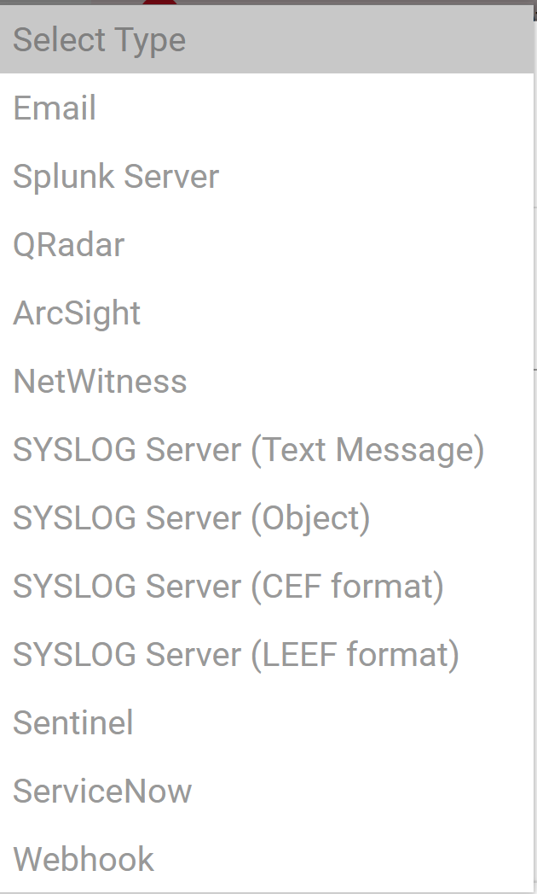
OPM - Define forwarding rules
Placeholder bullet

Slide 56
OPM - Define forwarding rules

Slide 57
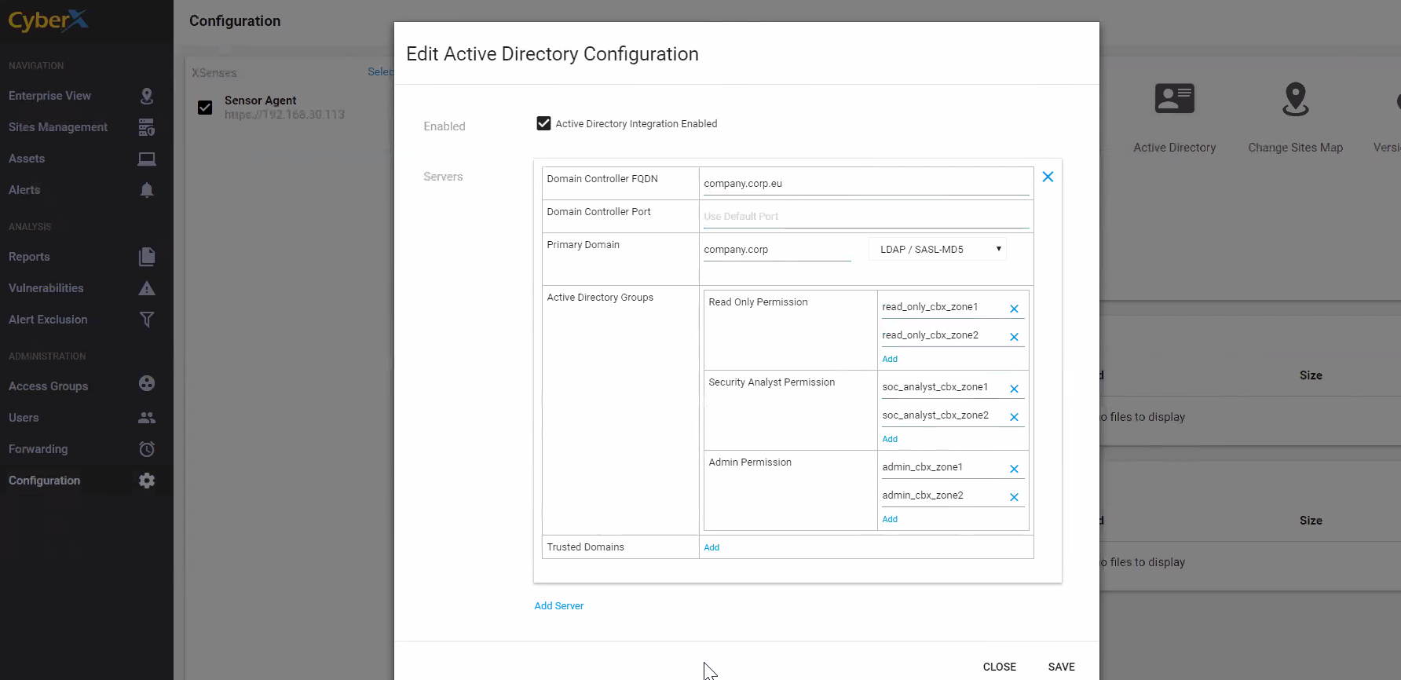
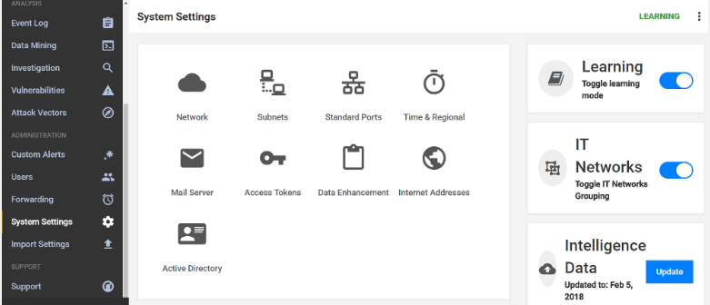
Active Directory Integration
Create groups in AD and add users to each group according to sensor permissions: read only/security analyst/admin.
Configure Sensor: via system settings -> Active Directory, edit AD configuration.
Define the LDAP parameters in sensor exactly as they appear in Active Directory
For all the Active Directory parameters use low case only, including when the configurations in your Active Directory use upper case
AD users can now login to sensor using the AD credentials, user will appear automatically at users module after first login.
Notes:
Note : users created manually via the GUI, will react seperately and will not be integrated with AD
Read Only: The Read Only (RO) user can access the Navigation section only.
Security Analyst: The Security Analyst user can access the Navigation and the Analysis sections.
Administrator: The Administrator user can access the Navigation, Analysis andAdministration sections.

Slide 58
Active Directory Integration
Create groups in AD and add users to each group according to sensor permissions: read only/ security analyst/ admin
Configure Sensor: via system settings -> Active directory, edit AD configuration
Define the LDAP parameters in sensor exactly as they appear in Active Directory
For all the Active Directory parameters use low case only, including when the configurations in your Active Directory use upper case
3. AD users can now login to sensor using the AD credentials, user will appear automatically at users module after first login.
Notes:
Note : users created manually via the GUI, will react seperately and will not be integrated with AD
Read Only: The Read Only (RO) user can access the Navigation section only.
Security Analyst: The Security Analyst user can access the Navigation and the Analysis sections.
Administrator: The Administrator user can access the Navigation, Analysis andAdministration sections.

Slide 59
Thank you

